Slide 1
Amazon Product Sales & Discount Analysis
Power BI Dashboard Summary | Task 3| 5 June, 2025
By Priya Dutta
For Elevate Labs Internship (Data Analyst)

Slide 2
Objective of the Dashboard
Analyse sales performance across the product categories
Compared actual vs. discounted price
Identify top performing categories and product ratings
Help stakeholders optimizing pricing and promotions

Slide 3
Data Overview
Total records analysed : 1466 products
Columns used : Category, Actual Price, Rating, Discount price, discount %, Reviews etc.
Source : Amazon product review Dataset taken from Kaggle.com

Slide 4
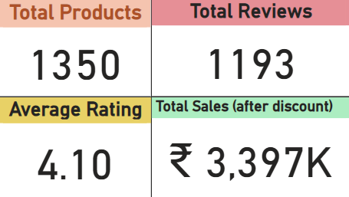
Key Performance Indicators (KPI’s)
Total Products : Used count (distinct) on the Product names
Total Reviews : Used count(distinct) on the review_id
Average Rating : Used average rating on Rating
Total Sales : Used Sum on discounted price

Slide 5
DAX (Data analysis expressions)
Used DAX for a new column : Category groups, Discounted Amount
Formula used : Category groups = SWITCH(TRUE(), CONTAINSSTRING(amazon[category], "Computer") || CONTAINSSTRING(amazon[category], "Electronics"), "Electronics" , CONTAINSSTRING(amazon[category],"Home" ), "Home" , CONTAINSSTRING(amazon[category], "Office"), "Office_products", CONTAINSSTRING(amazon[category], "Toys") || CONTAINSSTRING(amazon[category], "Music"), "Misc.")
Formula : Discounted Amount = amazon[actual_price] - amazon[discounted_price]

Slide 6
Power BI dashboard summary
Category(group) wise sale analysis Revealed Electronics as the Top-performing segment
Discount % analysis showed electronics had the highest average discount (52.1%)
Treemap visual highlighted the top 10 product categories by actual sales value
Insights used to recommend better discount strategies and category level focus
Added a slider of product categories under category groups to understand the sales better
Dashboard supports data-driven pricing and promotion decisions

Slide 7
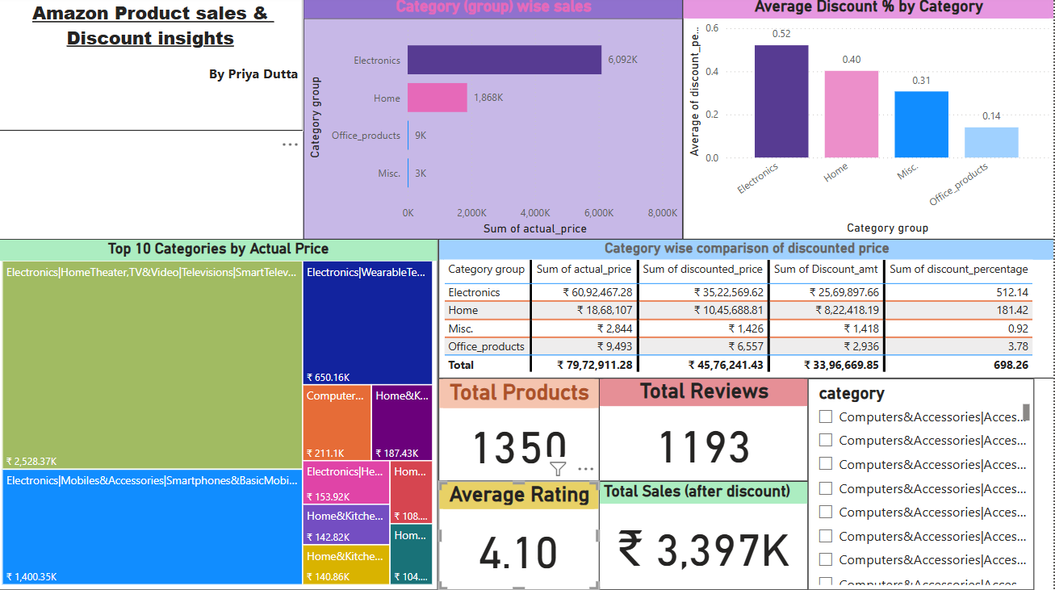
Power Bi Dashboard

Slide 8
Thankyou!

